Slide 1
OPIOIDS & MEDICATIONS USED TO TREAT MENTAL HEALTH DISORDERS
Dr. Jeffrey Carlson
Co-CEO & Chief Medical Officer of TeamCME

Slide 2
Medications, drug interactions, and side effects that medical examiners often encounter when performing exams for drivers with mental health conditions and those taking opioids will be covered in this presentation.

Slide 3
When evaluating medications, medical examiners should ask the driver what diagnosis is being treated with each medication.
An underlying disease that interferes with safe driving may be considered disqualifying
It is important to ask drivers how long they have been taking the medication and if they are having any current side effects with that medication.
In most instances, individuals experience less side effects the longer they are on the medication
The medication side effects discussed in this presentation occur in less that 30% of the population.

Slide 4
The Medication Standard
49 CFR 391.41(b)(12)
“A person is physically qualified to drive a commercial motor vehicle if that person- Does not use a controlled substance identified in 21 CFR 1308.11 Schedule I, an amphetamine, a narcotic, or any other habit-forming drug.
(12)(i) Does not use any drug or substance identified in 21 CFR 1308.11 Schedule I, an amphetamine, a narcotic, or any other habit-forming drug.
(ii) Does not use any non-Schedule I drug or substance that is identified in the other Schedules in 21 CFR part 1308 EXCEPT when the use is prescribed by a licensed medical practitioner, as defined in §382.107, who is familiar with the driver’s medical history and has advised the driver that the substance will not adversely affect the driver’s ability to safely operate a commercial motor vehicle.”
The Prescription Exception:
Paragraph (b)(12)(ii) allows a driver to be medically qualified when using a Schedule II through V drug if it is prescribed by a licensed medical practitioner who:
is licensed under applicable law to prescribe controlled substances and other drugs
is familiar with the driver’s medical history
has advised the driver that the substance will not adversely affect the driver’s ability to safely operate a commercial motor vehicle

Slide 5
Half-Life of Medications
The half-life is the amount of time it takes for half of the drug to be eliminated from the body. The shorter the half-life, the quicker the drug is eliminated.
It usually takes four half-life cycles for the body to eliminate 90-95% percent of a medication.

Slide 6
OPIOIDS

Slide 7
Commonly Prescribed:
Hydrocodone
Half-life: 7 to 9 hours
Oxycodone
Half-life: 3.5 to 4 hours
Morphine
Half-life: 2 to 4 hours
Fentanyl
Half-life: 3.7 hours
Buprenorphine
Half life: 20 to 42 hours
Methadone
Half life: 8 to 59 hours
Meperidine (Demerol)
Half life: 2.5 to 4 hours
Hydromorphone
Half life: 2.5 hours
Oxymorphone
Half life: 7.3 to 11.3 hours
Tramadol
Half-life: 6.3 to 7.9 hours
Tapentadol (Nucynta)
Half-life: 4 to 5 hours
Source: Epocrates

Slide 8
Opioids are schedule II controlled substances except Buprenorphine which is schedule III
Side Effects:
Psychomotor impairment
Dizziness, lightheadedness
Confusion
Somnolence
Headaches
Nausea/vomiting
Anxiety
Abdominal pain, constipation
Xerostomia (dry mouth)
The combination of opioids with various blood pressure medications or benzodiazepines can cause:
Hypotension
Respiratory depression
Arrhythmias
Psychomotor impairment
Sedation
Coma

Slide 9
STIMULANTS

Slide 10
AMPHETAMINES & METHYLPHENIDATES
Amphetamines & methylphenidates are central nervous system stimulants and are classified as schedule II drugs.
Prescribed for the treatment of ADHD and narcolepsy
Effects:
Controls hyperactivity
Provides increased energy
Increases focus
Decreases appetite
Side effects:
Anxiety
Tachycardia
Agitation
Dizziness
Headache

Slide 11
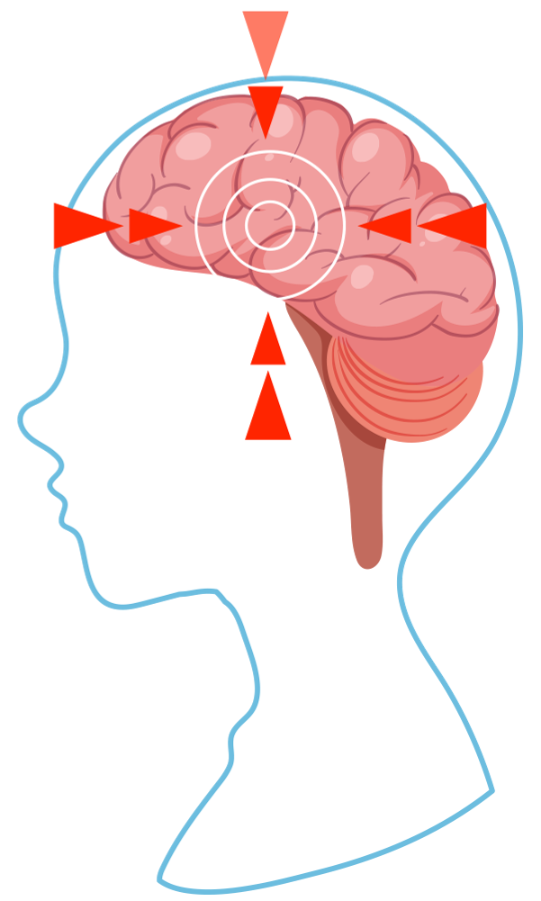
AMPHETAMINES & METHYLPHENIDATES
Lisdexamfetamine dimesylate (Vyvanse)
Half-life: 47 minutes
Methylphenidate hydrochloride (Ritalin)
Half-life: 3.5 hours
Amphetamine/dextroamphetamine sulfate (Adderall)
Half-life: 9 to 14 hours
Source: Epocrates

Slide 12
MODAFINILS
Stimulant medications that promote wakefulness and are used to treat excessive sleepiness caused by sleep apnea, narcolepsy, or shift work disorder.
Schedule IV controlled substance
Modafinil (Provigil)
Half-life: 15 hours
Armodafinil (Nuvigil)
Half-life: 15 hours
Side Effects:
Headaches
Anxiety
Insomnia
Anorexia
Dry mouth
Source: Epocrates

Slide 13
ANTIDEPRESSANTS

Slide 14
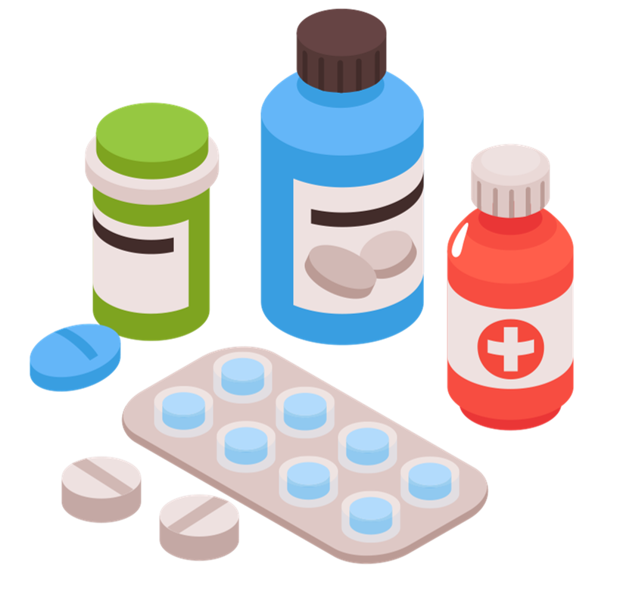
Tricyclic Antidepressants
Amitriptyline (Elavil)
10 to 26-hour half-life
Nortriptyline (Pamelor)
18 to 44-hour half-life
Imipramine (Tofranil)
11 to 25-hour half-life
Mirtazapine (Remeron)
20 to 40-hour half-life
Uses:
Depression
Post-traumatic stress disorder (PTSD)
Obsessive-compulsive disorder (OCD)
Fibromyalgia
Neuropathy
Migraines
Side Effects:
Drowsiness
Dizziness
Blurred vision
Tachycardia
Confusion
Fatigue
Source: Epocrates

Slide 15
Selective Serotonin Reuptake Inhibitors (SSRIs)
Fluoxetine (Prozac)
4 to 6-day half-life
Paroxetine (Paxil)
21-hour half-life
Sertraline (Zoloft)
26-hour half-life
Escitalopram (Lexapro)
27 to 32-hour half-life
Citalopram (Celexa)
35-hour half-life
Uses:
Depression
Anxiety
PTSD
OCD
Chronic pain
Side Effects:
Headaches
Tremor
Dizziness
Blurred vision
Impotence
Decreased libido
Source: Epocrates

Slide 16
Serotonin Norepinephrine Reuptake Inhibitors (SNRIs)
Venlafaxine (Effexor)
5-hour half-life
Desvenlafaxine (Pristiq)
11-hour half-life
Levomilnacipran(Fetzima)
12-hour half-life
Duloxetine (Cymbalta)
12-hour half-life
Uses:
Depression
Anxiety
Neuropathy
Fibromyalgia
OCD
Side Effects:
Headaches
Sleepiness
Anorexia
Dizziness
Blurred vision
Insomnia
Source: Epocrates

Slide 17
Norepinephrine-Dopamine Reuptake Inhibitors (NDRIs)
Bupropion (Wellbutrin)
21-hour half-life
Uses:
Major Depression Disorder
Season affective disorder
Smoking cessation
Side Effects:
Headaches
Tremor
Dizziness
Blurred vision
Insomnia
Tachycardia
Source: Epocrates

Slide 18
BIPOLAR DISORDER MEDICATIONS

Slide 19
Lamotrigine (Lamictal)
25-hour half-life
Anticonvulsant medication used for both seizures and bipolar disorder
Side Effects:
Headaches
Tremor
Dizziness
Ataxia
Vertigo
Blurred vision
Drug Interactions:
When taken with amphetamines may alter seizure control, cause psychomotor impairment, and increase risk of CNS depression
When taken with benzodiazepines or opiates may increase risk of respiratory depression
Carbamazepine (Tegretol)
25 to 65-hour half-life
Anticonvulsant medication used for seizures, bipolar disorder, and neuropathic pain
Side Effects:
Tremor
Dizziness
Ataxia
Drowsiness
Blurred vision
Drug Interactions:
When taken with acetaminophen increases risk of acetaminophen toxicity
When taken with doxycycline may decrease seizure threshold
Source: Epocrates

Slide 20
Lithium (Lithobid)
18 to 36-hour half-life
Used for both bipolar and depressive disorders
Side Effects:
Foggy brain
Decreased coordination
Drowsiness
Lithium toxicity
Hyponatremia
Fatigue
Drug Interactions:
Lithium levels can increase when taken with antacids
Valproic acid (Depakene)
16-hour half-life
Divalproex (Depakote)
9 to 16-hour half-life
Used for epilepsy, bipolar disorder, schizophrenia, and migraines
Side Effects:
Tremor
Headaches
Somnolence
Dizziness
Peripheral edema
Blurred vision
Tinnitus
Source: Epocrates

Slide 21
BENZODIAZEPINES

Slide 22
Benzodiazepines have a calming effect by causing the brain to be less sensitive to stimulation
Schedule IV drugs
Addiction potential
Used to treat anxiety, withdrawal, insomnia, and as an adjunctive medication for the treatment of seizures
Using Lyrica in conjunction with a benzodiazepine can increase the side effects
Side Effects
Drowsiness
Fatigue
Dizziness
Headaches
Poor coordination
Depression

Slide 23
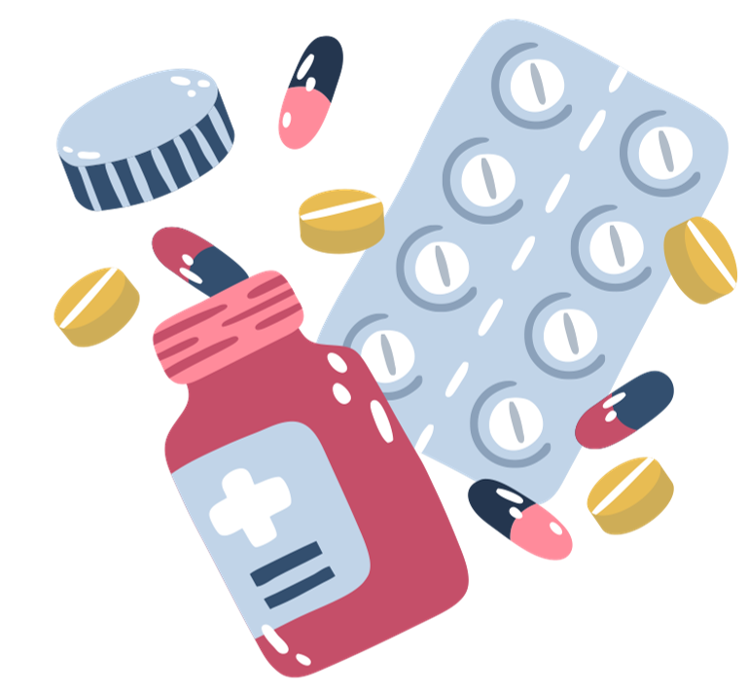
The lowest possible effective dose should be prescribed
Alprazolam (Xanax)
Half-life: 6-26 hours (short-acting)
Clonazepam (Klonopin)
Half-life: 20-50 hours (long-acting)
Diazepam (Valium)
Half-life: 20-100 hours (long-acting)
Lorazepam (Ativan)
Half-life: 10-20 hours (medium-acting)
Temazepam (Restoril)
Half-life: 10 to 20 hours
Chlordiazepoxide (Librium)
Half-life: 30 to 100 hours
Triazolam (Halcion)
Half-life: 2 to 5 hours
Source: Epocrates

Slide 24
ANTIPSYCHOTICS

Slide 25
Antipsychotics
First-Generation:
Second-Generation:
Used to treat:
Psychotic disorders
Bipolar disorder
Delirium
Hallucinations
Haloperidol (Haldol)
Fluphenazine (Prolixin)
Chlorpromazine (Thorazine)
Clozapine (Clozaril)
4 to 66-hour half-life
Quetiapine (Seroquel)
6 to7-hour half-life
Risperidone (Risperdol)
20-hour half-life
Olanzapine (Zyprexa)
21 to 54-hour half-life
Aripiprazole (Abilify)
75-hour half-life
All long-acting with half-life between 14.7 to 37 hours
Side Effects:
Drowsiness
Dizziness
Muscle spasms
Blurred vision
Drug interactions:
Can cause CNS depression when taken with opioids
Can cause irregular heart rhythms when taken with SSRI antidepressants
Can cause increased sedation, dizziness, or confusion when taken with benzodiazepines
Source: Epocrates

Slide 26
GABAPENTINOIDES

Slide 27
Anti-epileptic drugs that affect chemicals and nerves in the body involved in the prevention of seizures and specific types of pain.
Also used for treating:
Neuropathy
Fibromyalgia
Radiculopathy
Anxiety
Insomnia
Bipolar disorder
Alcohol dependence
Side Effects:
Dizziness
Somnolence
Fatigue
Blurred vision
Headache
Depression
Amnesia
Pregabalin (Lyrica)
Half-life: 6.3 hours
Schedule IV controlled substance
Gabapentin (Neurontin)
Half-life: 5-7 hours
Gabapentin is not classified
Source: Epocrates

Slide 28
THANK YOU

